Slide 1





SMART INDIA HACKATHON 2026
HARDWARE EDITION | MINISTRY OF EDUCATION & QUALCOMM INC.
PROJECT PHOENIX X
SAR UAV
Dual-Brain Edge-AI Scout for Zero-Infrastructure Disaster Reconnaissance
PROBLEM STATEMENT ID
THEME
SIH26177
Robotics and Drones
PROBLEM STATEMENT TITLE
A deployable AI-powered autonomous drone that aids search-and-rescue operations by detecting people and hazards, thereby improving responder safety and reducing victim discovery time.
SPONSORING ORGANIZATION
CATEGORY
Qualcomm Inc.
Hardware
Qualcomm Dragonwing QRB2210
TEAM NAME
TEAM ID
Phoenix X
141943
STM32U5 Zephyr RTOS Flight
Dual RGB + Thermal Fusion
WEB DEMO
VIDEO
3-5 km LoRa Telemetry
Tait-Bryan Ray-Casting GPS

Slide 2

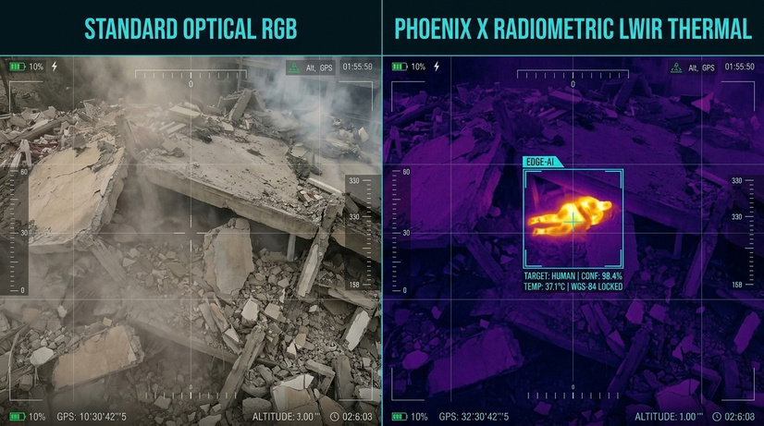





Disaster Reconnaissance & Emergency Survivor Triage
PROBLEM STATEMENT
PROPOSED SOLUTION
IN CATASTROPHIC DISASTERS (LANDSLIDES, EARTHQUAKES), FIRST RESPONDERS FACE FOUR CRITICAL BARRIERS:
  COMMS BLACKOUT: Downed towers & power grids; cloud-AI drones rendered inoperable.
  ZERO VISIBILITY: Mud slush, smoke, and darkness blind standard visual cameras.
  HIGH MORTALITY: The Golden 72 Hours expire before manual foot sweeps reach victims.
  RESPONDER HAZARDS: Teams advance blindly into live wires, gas leaks, and shifting debris.
Project Phoenix: An autonomous, field-deployable multirotor scout engineered for offline disaster zones:
  100% ON-DEVICE AI: Executes real-time vision on Qualcomm silicon without internet.
  MULTI-SPECTRAL VISION: Fuses 4K RGB with LWIR Thermal (8-14μm) to spot living body heat (37°C).
  TAIT-BRYAN RAY-CASTING: Calculates victim Lat/Long GPS coordinates instantly from altitude.
  OFFLINE TACTICAL GCS: Streams priority triage queues and safe rescue routes to local operators.
INNOVATION / UNIQUENESS
Dual-Brain Architecture
5W Edge YOLO
Ray-Cast Geolocation
ROS-LoRa P2P Bridge
Anti-Compass Drift VIO
Arduino UNO Q combining Qualcomm QRB2210 MPU + STM32U5 MCU in 40g.
INT8 YOLO identifies victims & flight obstacles on Qualcomm NPU; preserves 90% power for rotors.
Tait-Bryan rotation matrix projects bounding boxes to ground GPS pins.
17-byte bit-packed telemetry stream over 5+ km (Souli et al., Elsevier 2024).
Visual-Inertial Odometry overrides magnetometer in collapsed steel rubble (IEEE).
TRADITIONAL DISASTER SEARCH
(Current Approach)
Manual Foot Sweeps
Blind Rubble Digging
Stalled at Sunset (Darkness)
High Responder Casualty Risk
Critical Hours Lost
PHOENIX AUTONOMOUS SAR
(Our Approach)
Autonomous Aerial Sweep
24/7 Thermal Night Vision
Instant Survivor GPS Raycasting
Zero-Drop LoRa Telemetry
Safe Responder Path Routing
PROJECT PHOENIX: Autonomous Multi-Spectral Edge-AI UAV | SIH26177 (Qualcomm Inc.)
2
Notes:
2

Slide 3
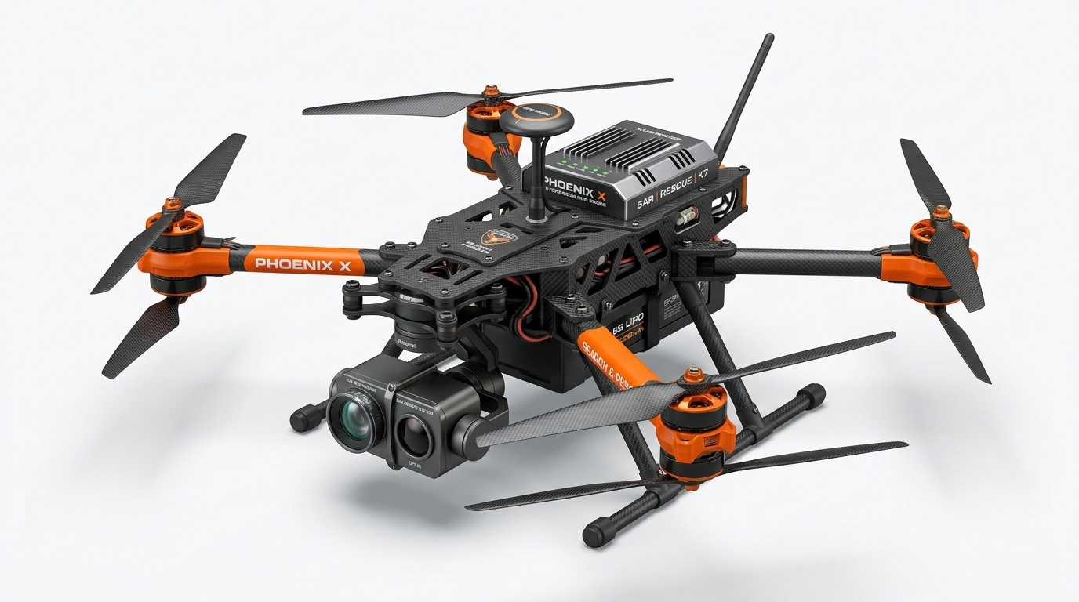
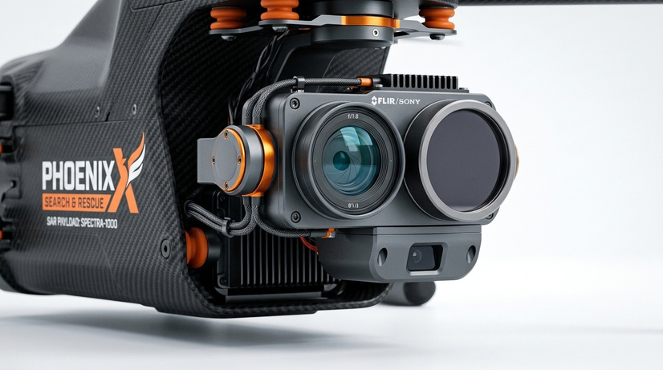
TECHNICAL APPROACH
Dual-Brain Architecture & Workflow
IMPLEMENTATION WORKFLOW
SYSTEM ARCHITECTURE
Sector Partition & Launch
Dual-Brain Hardware Split (Arduino UNO Q):
1
Operator selects 2 km² search polygon on offline tablet; UAV launches in < 3 minutes.
Real-Time MCU (STM32U585 / Zephyr RTOS):
  250 Hz (4ms) deterministic flight stabilization loop
  350 Hz PWM direct brushless motor control
  IMU (MPU6050) + Barometer (MS5611) + Downward LiDAR
2
Autonomous Grid Sweep
Boustrophedon decomposition with 60% sidelap & 70% overlap; ToF altimeter maintains constant GSD over sloped terrain.
Asynchronous non-blocking RPC bridge
3
Multi-Spectral Perception
Mission Computer (Qualcomm Dragonwing QRB2210 / Linux):
Dual 4K RGB + LWIR Thermal fusion; edge YOLO identifies survivor heat contours (37°C) & flags obstacles for flight avoidance.
  Dual-Task INT8 YOLO (Survivor Triage + Flight Obstacle Avoidance) // Ray-Caster
Semtech SX1262 LoRa Telemetry Driver (868 MHz)
4
Ray-Cast Geolocation
Transforms 2D bbox offset via 3D Tait-Bryan DCM matrix & ToF altitude (ΔP = H_AGL · R·v) to pin GPS on the fly.
TECH STACK
5
Binary LoRa Packet Burst
Souli et al. (2024) protocol packs survivor coordinates into 17-byte binary frame; broadcasts over 5+ km.
Flight Stack
Zephyr RTOS, YMFC-32 Core, PX4 Autopilot
Edge AI & Vision
YOLOv8n INT8 (Detection & Avoidance), SNPE, OpenCV
GCS Triage & Route Planning
Robotics Middleware
ROS2 Humble, MAVLink v2, micro-ROS
6
Long-Range RF Comms
Semtech SX1262 LoRa P2P (868 MHz)
Offline GCS computes priority triage queue and charts a hazard-aware Dijkstra safe walking corridor avoiding live wires directly to casualty.
Tactical GCS
React, Leaflet, Tailwind CSS, WebSockets
Security
HMAC-SHA256 Telemetry Packet Signatures
PROJECT PHOENIX: Autonomous Multi-Spectral Edge-AI UAV | SIH26177 (Qualcomm Inc.)
3
Notes:
3

Slide 4






FEASIBILITY AND VIABILITY
Feasibility, Challenges-to-Strategies & Market Viability
FEASIBILITY
VIABILITY
CHALLENGES → STRATEGIES
TECHNICAL FEASIBILITY
ECONOMIC VIABILITY
Prototype cost: <40,000₹
1
Comms Blackout in Canyons
  Bouabdallah Sizing Laws: 38% battery mass fraction, β ≥ 2.0 thrust-to-weight ratio.
  Total All-Up-Weight: 1.58 kg (Comfortably under DGCA 2.0 kg Micro Category).
  Sub-5W Compute: Qualcomm NPU preserves 90% power for rotor propulsion.
→ Strategy: 868MHz LoRa packet bridge in NLoS canyons (Pérez-Díaz-de-Cerio et al., IEEE Access 2026).
Enterprise Drone Disruption costs:
2
Smoke, Mud Slush & Darkness
DJI Matrice 30T
₹10+ Lakhs
Phoenix
₹1.2 Lakh
→ Strategy: 8-14μm LWIR thermal fusion in dense smoke & fire (Siotia et al., IEEE Access 2026).
OPERATIONAL FEASIBILITY
  Fleet Scalability: NDRF battalions can deploy a swarm of 5 Phoenix UAVs for the price of 1 commercial drone.
3
Rubble Steel Magnetometer Distortion
  Setup Time: < 3 minutes from rugged backpack unboxing to flight.
  Quick-Swap Battery: Dual 4S LiPo tray for continuous sortie coverage.
→ Strategy: Visual-Inertial Odometry overrides magnetometer in collapsed rebar (IEEE).
NATIONAL DATA SOVEREIGNTY
  100% Air-Gapped: Zero telemetry leaked to foreign cloud servers; adheres to Indian Defense & Home Ministry cyber norms.
4
Propeller Vibration Sensor Noise
FINANCIAL FEASIBILITY
→ Strategy: Notch-filtered EKF & harmonic vibration dampening (Bouabdallah, IEEE IROS).
  Prototype Build: ₹35,800 (Calibrated Functional Prototype).
Production BOM: ₹85,000 – ₹1,20,000 per unit (10x cheaper than commercial enterprise drones).
DEPLOYMENT ECOSYSTEM
  Seamless integration into state disaster management authorities (NDRF, SDRF, Indian Army disaster columns).
5
Actuator Saturation in Gusts
→ Strategy: Anti-windup integrator clamping on 400Hz PID loop (Bouabdallah, IEEE ICRA).
PROJECT PHOENIX: Autonomous Multi-Spectral Edge-AI UAV | SIH26177 (Qualcomm Inc.)
4
Notes:
4

Slide 5




IMPACT AND BENEFITS
Mission Impact & Multi-Stakeholder Benefits
TRAPPED VICTIMS
NDRF / SDRF TEAMS
DISASTER AUTHORITIES
DISTRICT GOVERNANCE
  Located in Golden 72h window
  Discovered through mud & debris
  Rapid medical triage prioritization
  Maximized chances of survival
  Advance hazard mapping
  Avoid live cables & gas leaks
  Automated safe-route navigation
  Reduced physical rescuer fatigue
  Unified local tactical map
  Real-time survivor count & coords
  Zero dependency on cell towers
  Dynamic search sector logging
  Efficient resource allocation
  Targeted airlift & medical drops
  Post-disaster audit trails
  Affordable procurement at scale
IMPACT PIPELINE
1 DEPLOY
2 SEARCH
3 LOCATE
4 RESPOND
5 OUTCOME
PHOENIX DOES
Backpack to flight with no infrastructure
Flies an autonomous sweep with RGB + thermal vision
Pins each detected survivor with GPS coordinates
Ranks survivors and plots a hazard-free route
Delivers all this at a fraction of enterprise-drone cost
IMPACT
Search starts within minutes of arrival
Search continues at night and in smoke or fog
Rescuers go straight to survivors, not digging blind
Crews avoid cave-ins, gas leaks and live cables
More survivors reached in the Golden 72 hours
MEASURE
< 3 min
2 km²
0 cell towers
Ranked queue
₹1.2 Lakh
unboxing to flight
search sector
needed to report locations
+ safe rescue route
vs ₹12-14 Lakhs
PROJECT PHOENIX: Autonomous Multi-Spectral Edge-AI UAV | SIH26177 (Qualcomm Inc.)
5
Notes:
5

Slide 6



RESEARCH AND REFERENCES
Academic Research Foundations & Prototype Verification
RESEARCH & REFERENCES
PROTOTYPE PROOF
01
IIT Jodhpur & Manipal (IEEE Access, Sept 2026)
OPEN-SOURCE REPOSITORY & VERIFICATION ASSETS
  • 'SwarmSAR-FW: Drone-Based Swarm Search and Rescue in Fire and Water Disasters'
• Sourced & validated Hazard-Aware Safe Access Ingress Routing for ground crews & 98.7% triage.
Video link: SIH Grand Finale Submission Portal
Presentation Video:
02
UPC Spain & Souli et al. (IEEE Access 2026 / Elsevier 2024)
Web Demo:
Github Repo:
  • 'Long-Range BLE Detection via Drone LoRa Relays' & 'Mission-Critical ROS-LoRa Architecture'
• Sourced 868 MHz LoRa off-grid data bridge & 17-byte binary telemetry in cellular blackout zones.
phoenix-sar-uav.vercel.app
github.com/jvstin47/Phoenix-SIH26177-SAR-UAV
Documented Subsystems:
03
TalTech Estonia (IEEE Access, 2023)
1. docs/research_papers_synthesis_2026.md
2. docs/prototype_bom_and_financial_viability.md
3. docs/ros_lora_mission_critical_uav_swarm_research.md
4. docs/bouabdallah_quadrotor_research_findings.md
  • 'Applying RIS-Based Communication for Collaborative Computing in a Swarm of Drones'
• Validated decentralized swarm edge-computing without cloud servers (-32% energy, -18% latency).
Also cited: Albanese et al., SARDO — SDR victim localization baseline (IEEE TMC, 2022). Phoenix X: equivalent accuracy at 1/8th payload.
Prototype Architecture Deliverables:
Dr. Samir Bouabdallah (EPFL Thesis 3727 / IEEE ICRA, 2007)
Live Web GCS Tactical Dashboard (React + Leaflet)
04
Multi-Spectral Dual Stream (RGB + LWIR Thermal HUD)
  • 'Design and Control of Quadrotors with Application to Autonomous Flying'
• Sourced 12-state rigid-body dynamics, 90/10 electrical propulsion ratio, and anti-windup integrator.
Also cited: Mishra et al. (BITS Pilani & Bennett Univ.) — CNN aerial detection dataset (Elsevier Comp. Comm., 2020).
LoRa 17-Byte Binary Bit-Packing Serialization Module
Ray-Casting Geolocation Python Engine
PROJECT PHOENIX: Autonomous Multi-Spectral Edge-AI UAV | SIH26177 (Qualcomm Inc.)
6
Notes:
6

